Slide 1
ENTITY-RELATIONSHIP MODEL
PREPARED BY:-
SNEHA PADHIAR

Slide 2
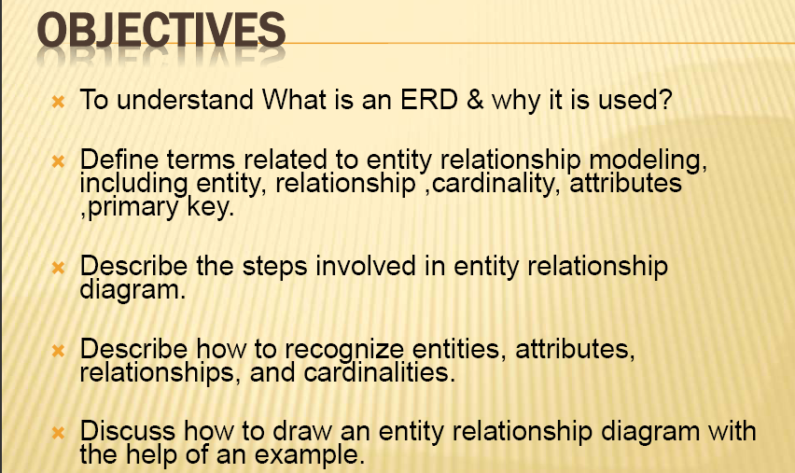

Slide 3
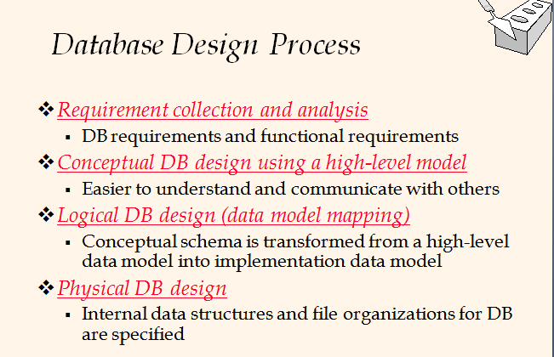

Slide 4
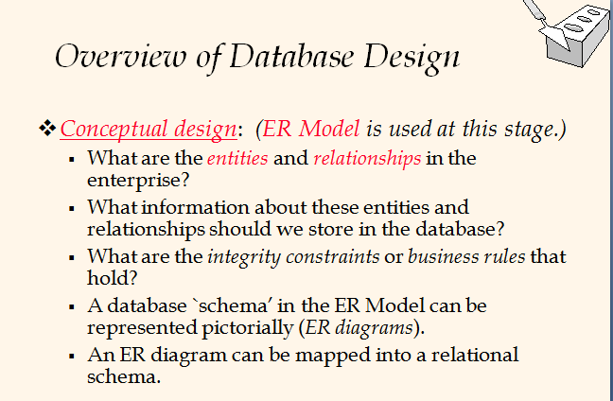

Slide 5
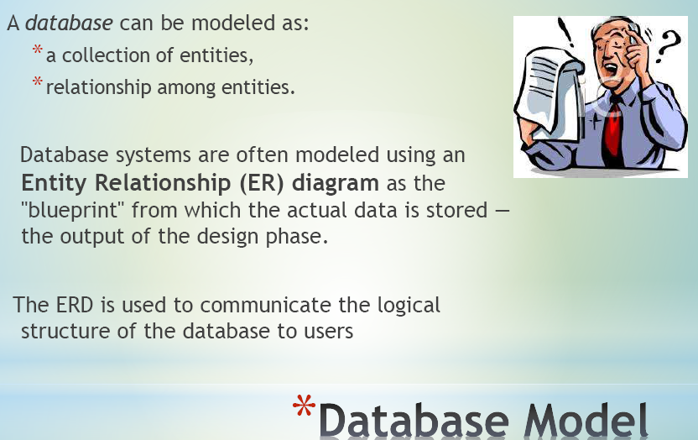

Slide 6
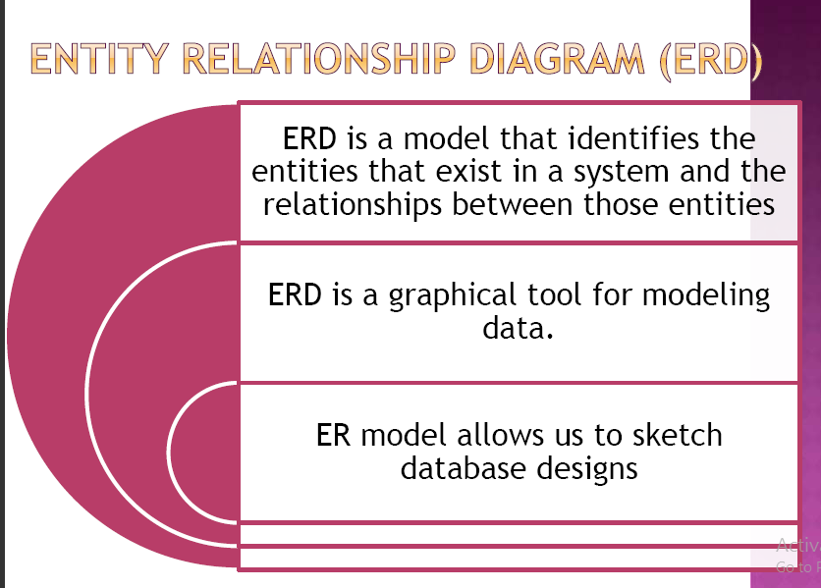

Slide 7
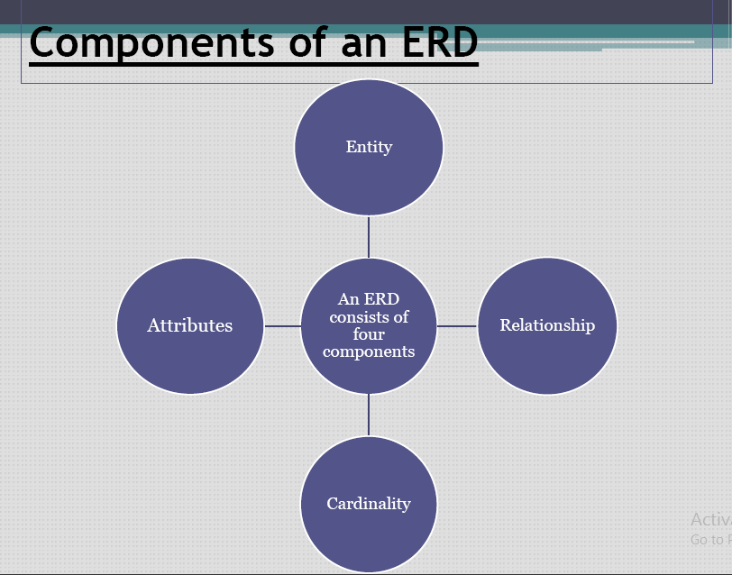

Slide 8
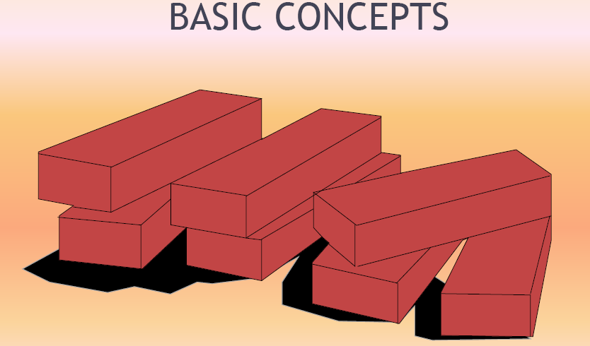

Slide 9
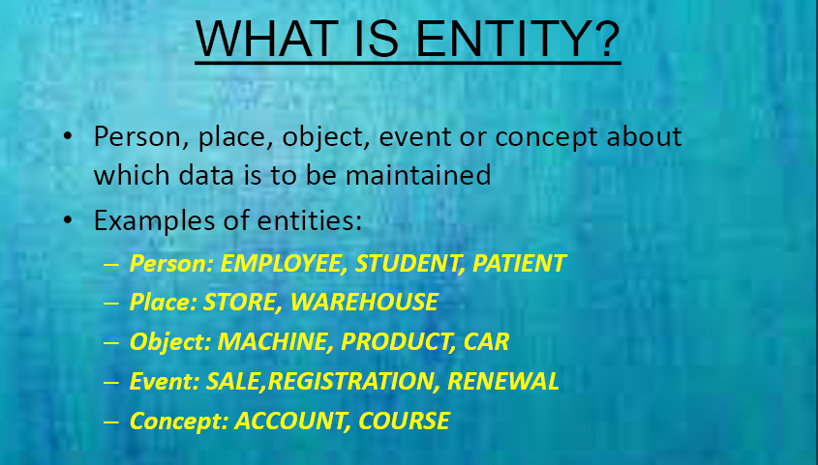

Slide 10
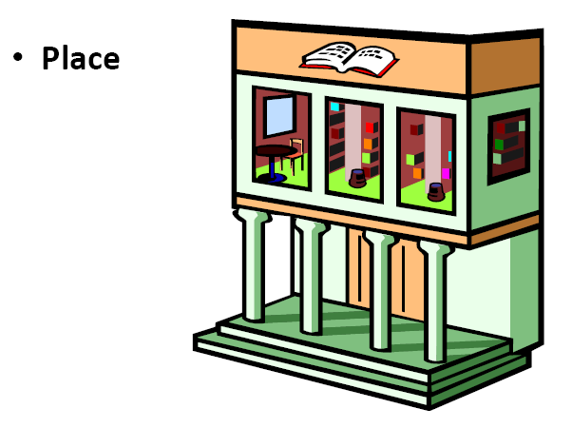

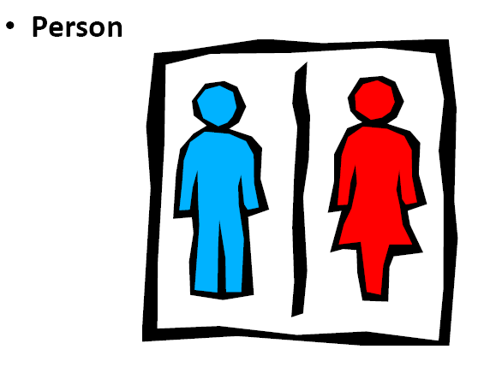
ENTIY IS…

Slide 11
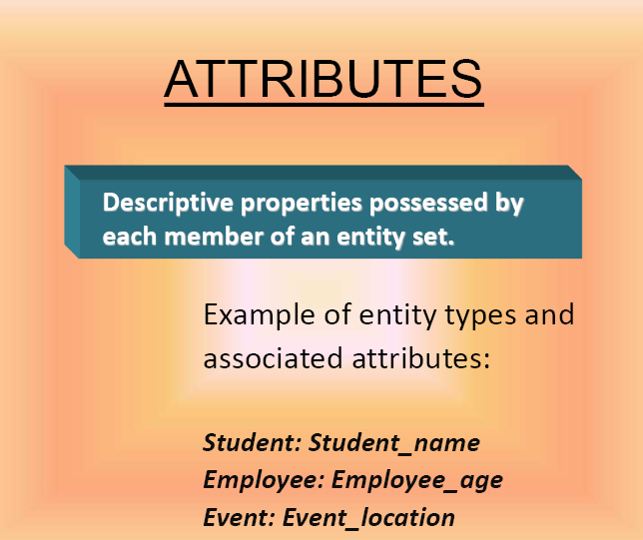

Slide 12
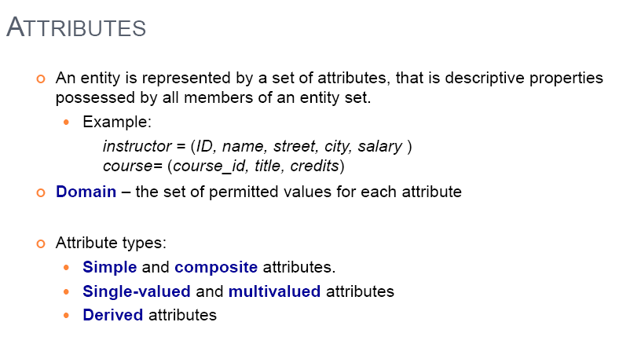
ATTTRIBUTE

Slide 13
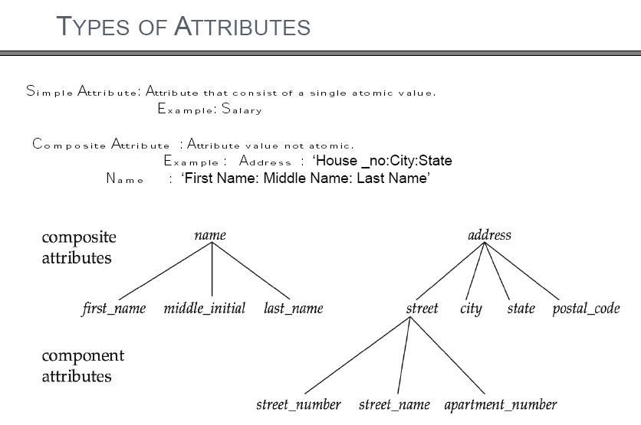
ATTTRIBUTE TYPES

Slide 14
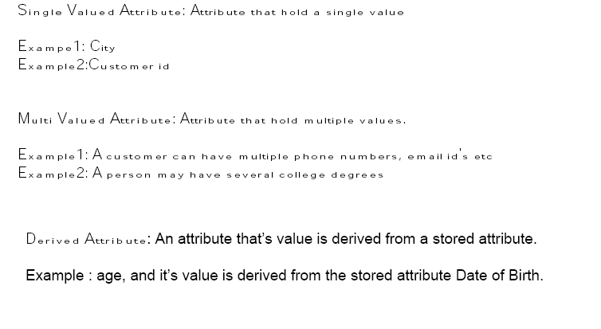
ATTTRIBUTE TYPES

Slide 15
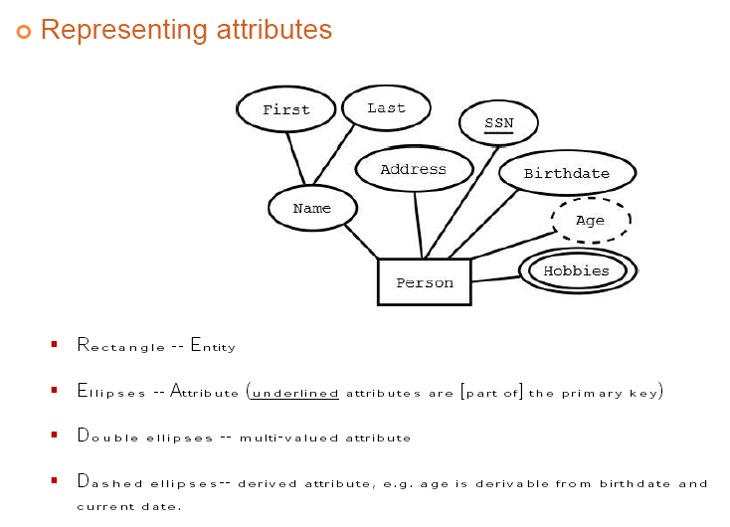
ATTRIBUTE REPRESENTATION

Slide 16
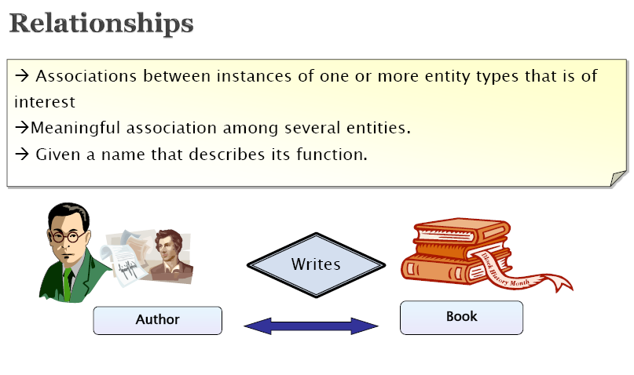
RELATIONSHIPS

Slide 17
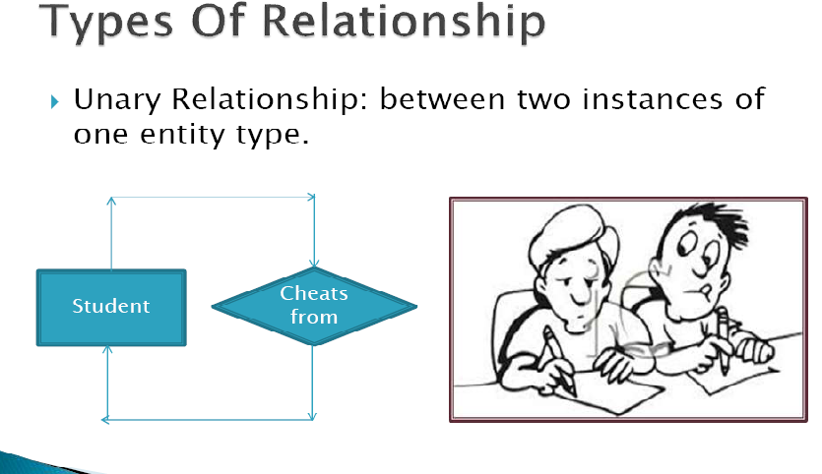

Slide 18
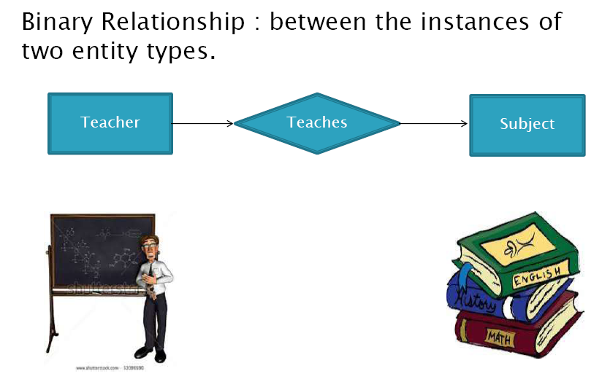

Slide 19
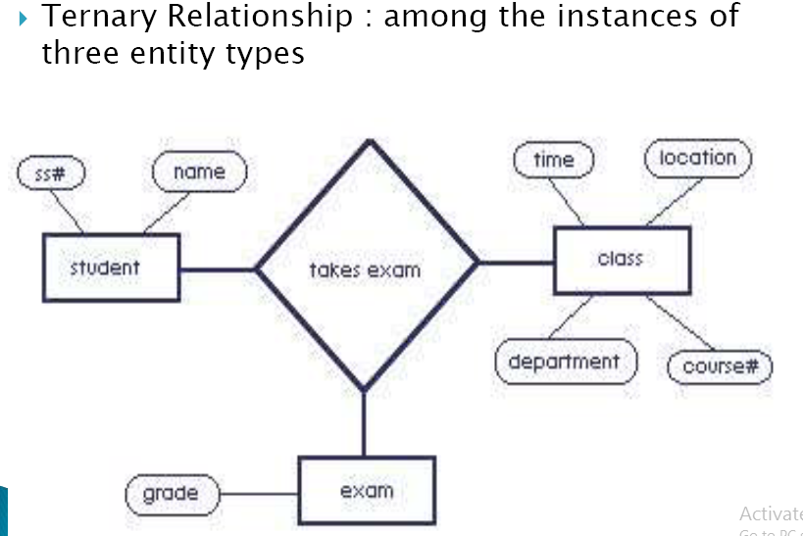

Slide 20
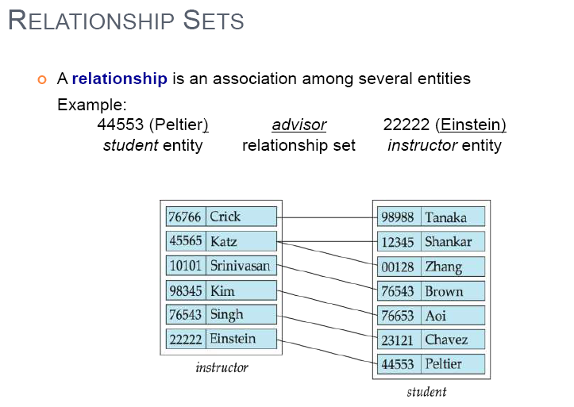
RELATIONSHIP SETS

Slide 21
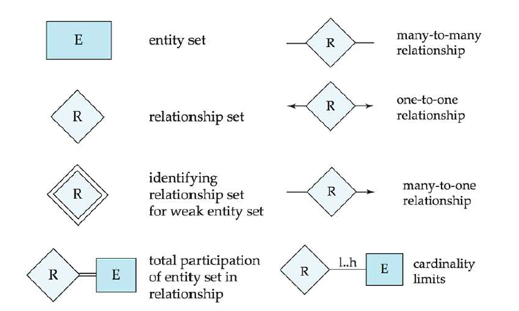
E-R NOTATIONS

Slide 22
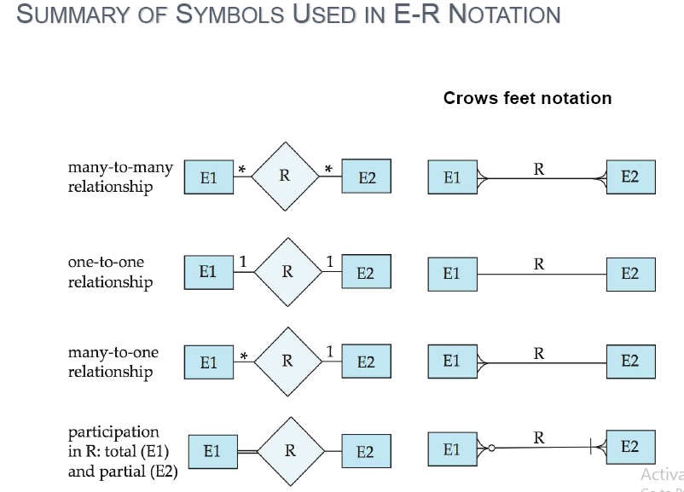

Slide 23
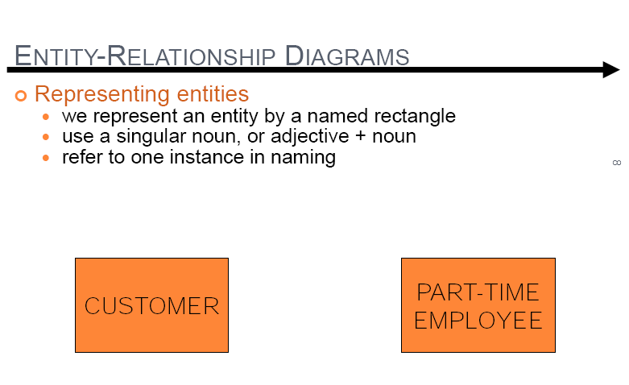

Slide 24
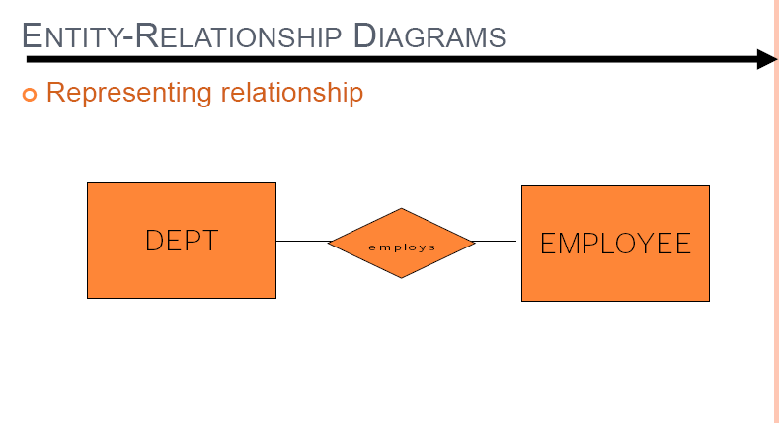

Slide 25
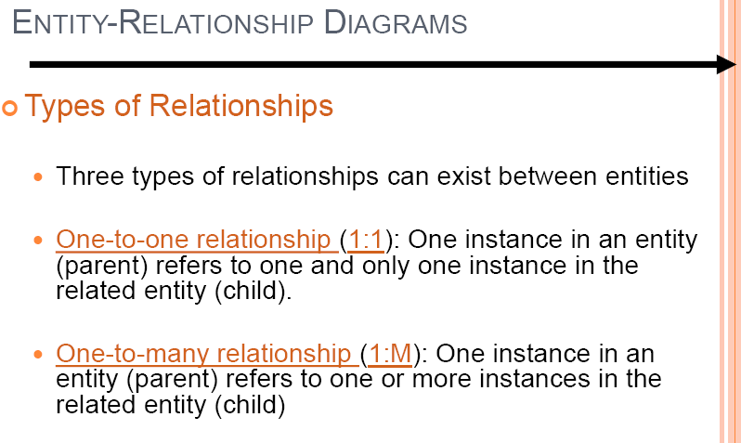

Slide 26
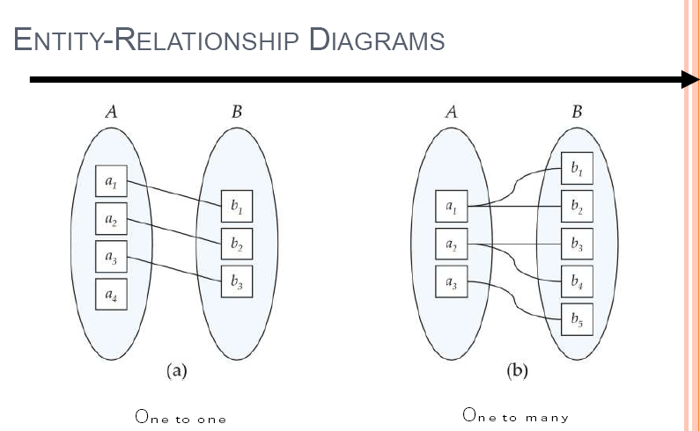

Slide 27
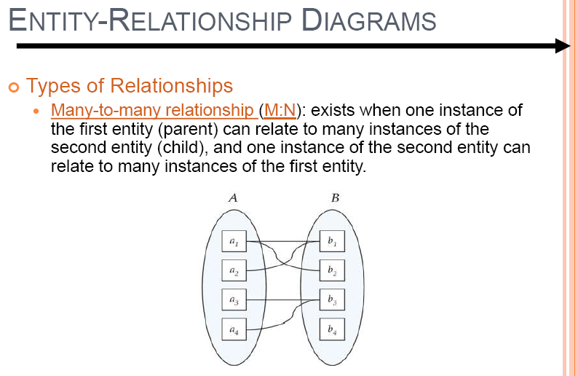

Slide 28
CONSTRAINTS
MAPPING CONSTRAINTS
PARTICIPATION CONSTRAINTS

Slide 29
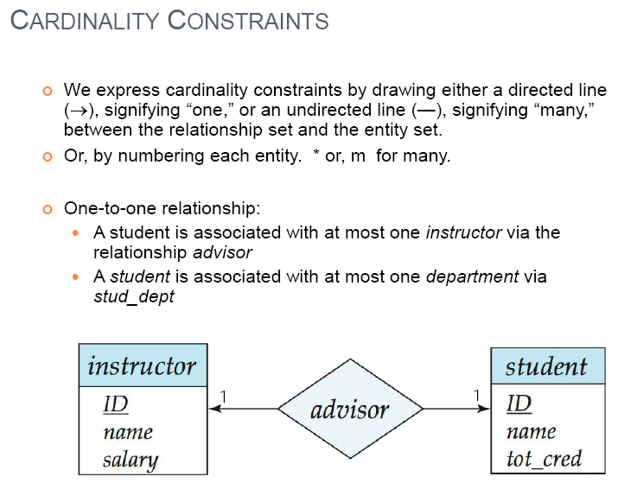
CARDINALITY CONSTRAINTS

Slide 30
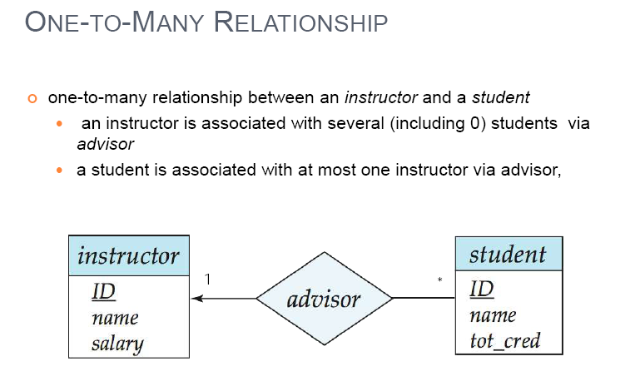

Slide 31
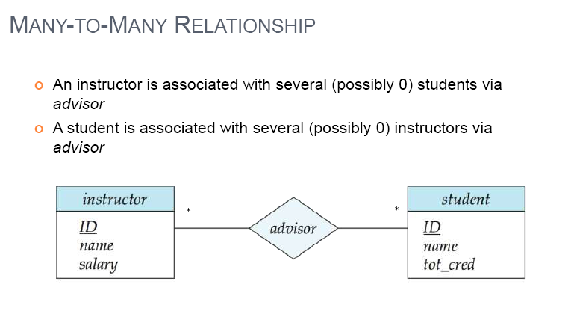

Slide 32
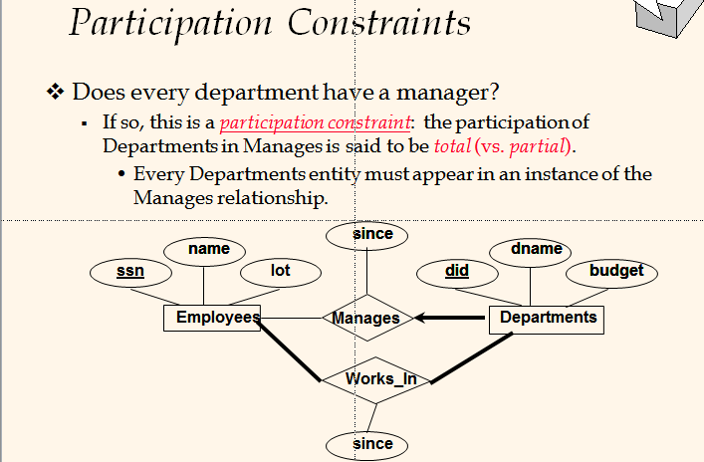

Slide 33
Total Participation:
The Participation of an entity set E in a Relationship set R is Said to be Total if every entity in E Participates in at least one Relationship in R.
Partial Participation:
If only Some Entities in E participates in Relationships in R, The participation of entity set E in Relationship R is said to be partial.
Ex: we expect that every loan entity to be related to at least one customer through the borrower relationship,therefor, the participation of loan in the relationship set Borrower is TOTAL.
Ex: While, a bank customer may or may not have a loan. Therefore, the participation of customer in the Borrower relationship is PARTIAL.

Slide 34
KEYS

Slide 35
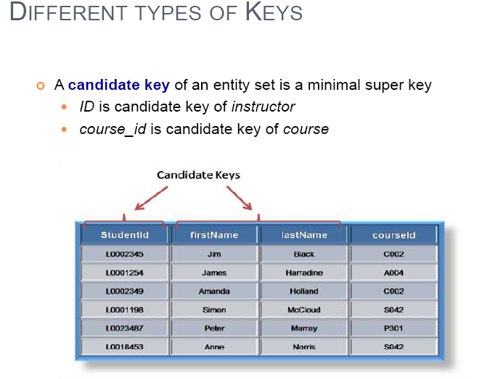

Slide 36
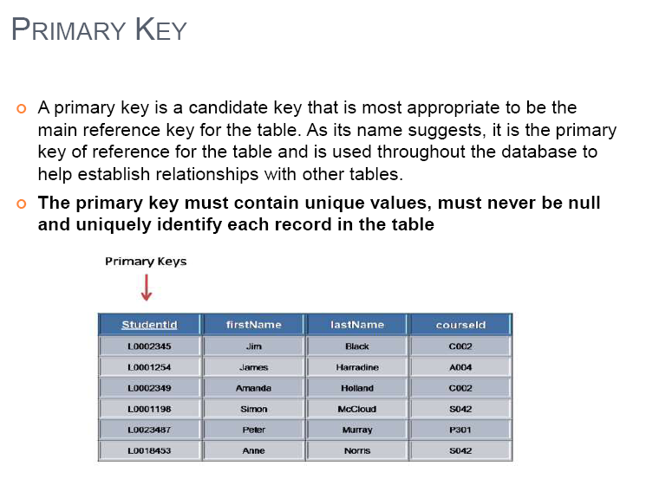

Slide 37
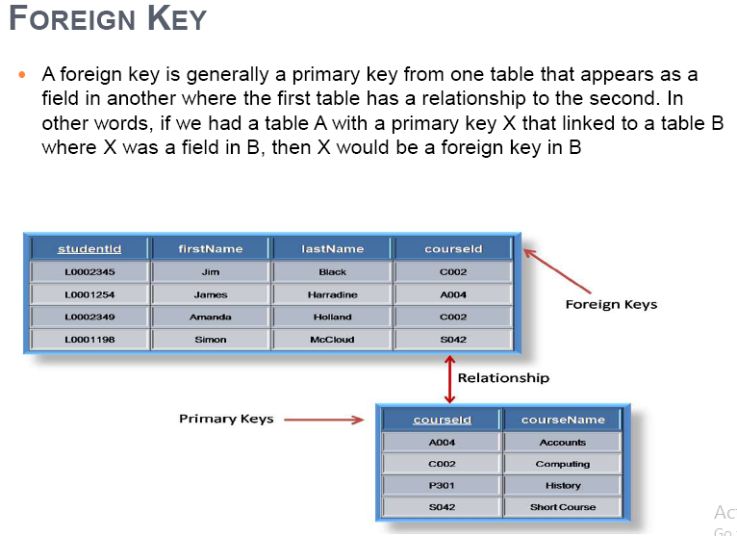

Slide 38
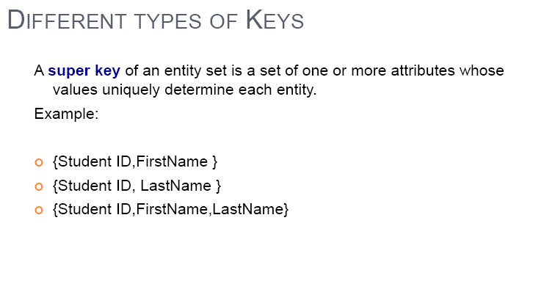

Slide 39
EXISTANCE DEPENDENCY
Weak Entity Type
A weak entity is one whose existence is dependent on some other entity type
Sometimes referred to as child, dependent or subordinate entities.
Strong Entity Type
A strong entity is one whose existence is NOT dependent on some other entity type
Sometimes referred to as parent, owner or 2 dominant entities

Slide 40
EXTENDED E-R MODEL
SPECIALIZATION
GENERALIZATION
AGGREGATION

Slide 41
Generalization - the process of defining a general entity type from a collection of specialized entity types.
Specialization - the opposite of generalization, since it defines subtypes of the super type and determines the relationship between the two.

Slide 42
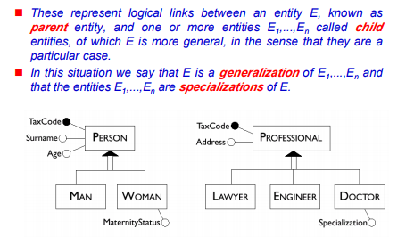

Slide 43
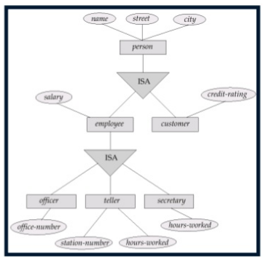
GENERALIZATION

Slide 44
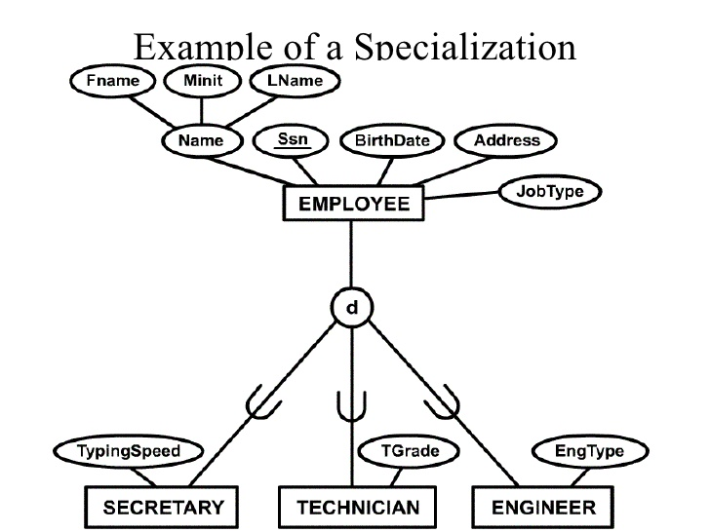

Slide 45
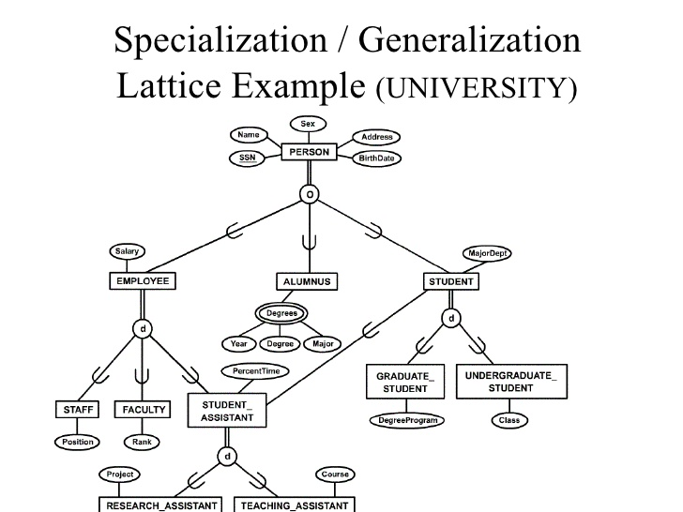

Slide 46
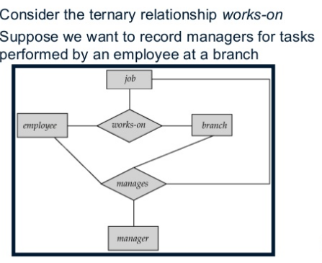
AGGREGATION

Slide 47
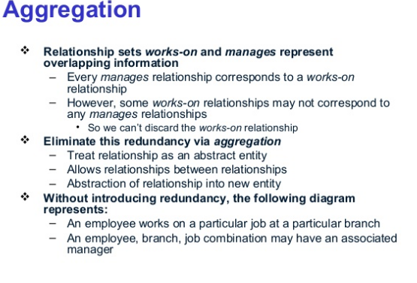

Slide 48
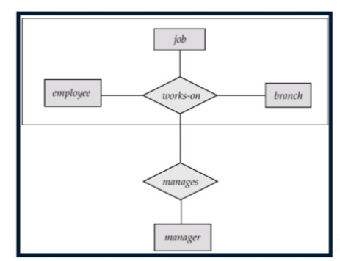

Slide 49
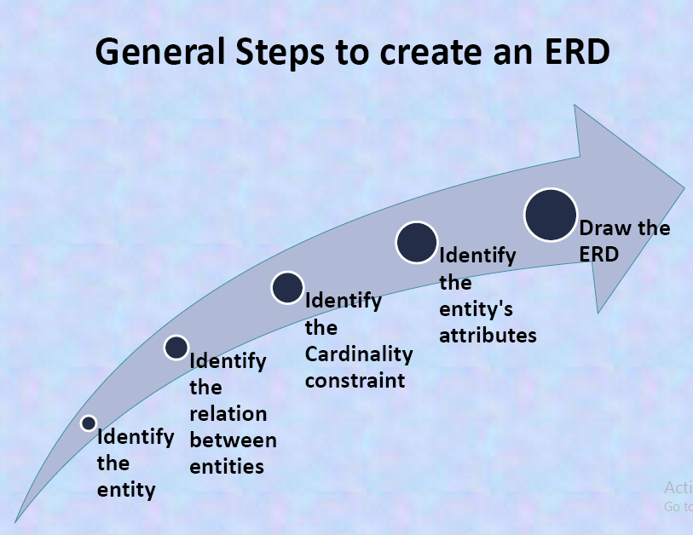

Slide 50
E-R DIAGRAM EXAMPLES

Slide 51
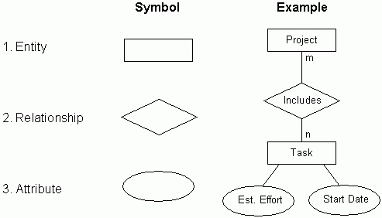

Slide 52
E-R NOTATIONS

Slide 53
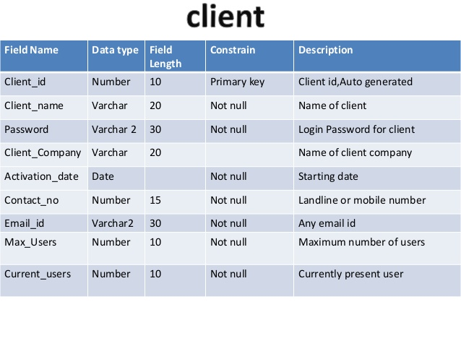
DATA DICTONARY
A data dictionary is a collection of descriptions of the data objects or items in a data model for the benefit of programmers and others who need to refer to them.

Slide 54
BANKING MANAGEMNET SYSTEM
TICKET BOOKING SYSTEM
UNNIVERSITY MANAGEMNET SYSTEM
LIBRARY MANAGEMENT

Slide 55
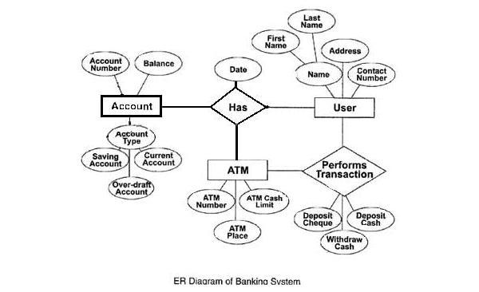

Slide 56
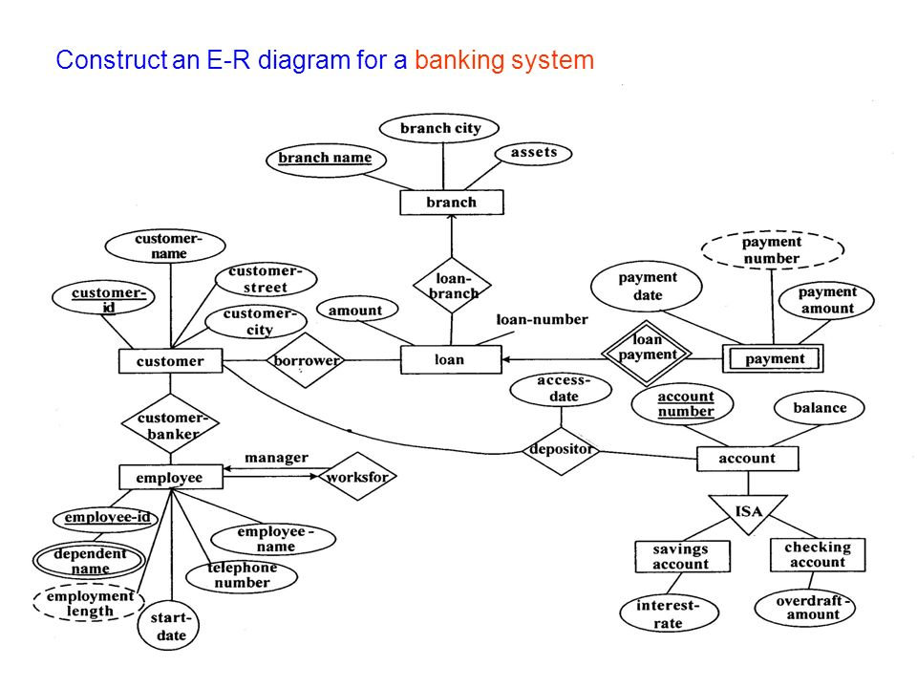

Slide 57
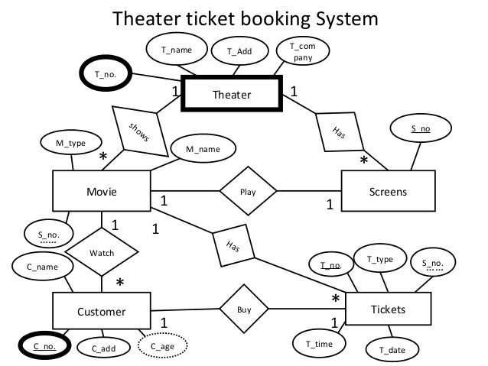

Slide 58
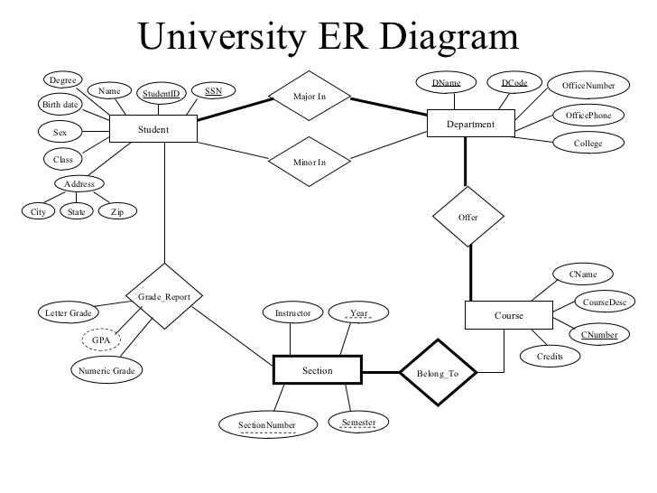

Slide 59
DESAIGN ISSUES
Use of Entity Sets VS Attributes
employee:-emp_id,emp_no,emp_name,telephone_no
telephone:-telephone_no, location(home/office)
Que is whether to represent telephone_no as attribute or entity?
Use of Entity Sets VS Relationship sets
ex:-entity:loan
ex:- relationship: Relationship between customer & branches with loan_no & amount as descriptive attribute.

Slide 60
QUICK QUIZ
1)
In E-R Diagram relationship type is represented by
A. | Ellipse
B. | Dashed ellipse
C. | Rectangle
D. | Diamond
2)In E-R diagram generalization is represented by
A. | Ellipse
B. | Dashed ellipse
C. | Rectangle
D. | Triangle

Slide 61
3)In the relational model, the number of attributes and number of tuples iri a
relation are termed as __________and ______________respectively
A. | Cardinality, domain
B. | Degree, cardinality
C. | Domain degree
D. | Cardinality, degree
4)Given the basic ER and relational model which of the following is incorrect?
A. | An entity can have more than one attrbute
B. | An attribute of an entity can be composite.
C. | In row of a relational table, an attribute have more than one value.
D. | In row of a relational table, an attribute can have exactly one vlaue or a NULL value.

Slide 62
PRACTICE QUESTION
1) Let E1 and E2 be two entities in an ER diagram with simple single-valued attributes. R1 and R2 are two relationships between E1 and E2, where R1 is one-to-many and R2 is many-to-many. R1 and R2 do not have any attributes of their own. What is the minimum number of tables required to represent this situation in the relational model? (a) 2 (b) 3 (c) 4 (d) 5 Ans: option (b) Explanation: Strong entities E1 and E2 should be converted into tables. For R1, which is one to many relation, there is no need of a separate table. Modify the "many" side to include the primary key of "one" side as foreign key. For R2, which is many to many relation, we require a separate table by including the primary key of E1 and E2 as foreign keys. Hence we require a minimum of 3 tables.

Slide 63
2)Given the basic ER and relational models, which of the following is INCORRECT?
(a) An attribute of an entity can have more than one value
(b) An attribute of an entity can be composite
(c) In a row of a relational table, an attribute can have more than one value
(d) In a row of a relational table, an attribute can have exactly one value or a NULL value
Ans: option (c)
Explanation:
According to First Normal Form, an attribute cannot have multiple values.

